Slide 1

Shell Scripting next steps
VITLUG - Session 2

Slide 2
Last Session Recap
Shell is a command line interpreter which acts like an interface between the kernel and the user.
Changing your default shell -
~$ cat /etc/shells
~$ chsh username -s new_default_shell
Executing your shell script -
~$ chmod a+x hello-world.sh
~$ ./hello-world.sh

Slide 3
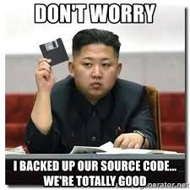
You want the code?
https://git.io/JvR46

Slide 4
Let’s Start!
I Want you to code along
with me.

Slide 5
Application #1
File Handling

Slide 6
Application #2
System Maintenance

Slide 7
Application #3
CURL
It’s cURL, not curl!

